Slide 1
Data analysis project
Analytics for Change
Analytics for Change / VLA

Slide 2
Vision
Students
NFPs
Mentors
VLA partnered with volunteer students and professionals from Analytics for Change.
We wanted to use their data analytics skills to analyse a de-identified data set spanning a ten year period, 2006-2016.
Analytics for Change
VLA
Notes:
Last year, after trying to get a program going with RMIT, we ended up getting together with a group of senior Data Analytics students, who were trying to establish a real world project with NFPs

Slide 3
Research Questions
How do people use our services?
Who are our most ‘costly’ clients? Are there clients who are more likely to need to use our services most often, or need our most intensive services?
Are some legal problems more likely to co-occur?
Do some clients, for example,
young people,
Aboriginal and Torres Strait Islanders (ATSI)
People who speak a language other than English (LOTE)
use services differently from the rest of the VLA client group?
Notes:
met to establish some questions for them to answer (read dot point four) and wanted them to look at client data over a 10 year period.

Slide 4
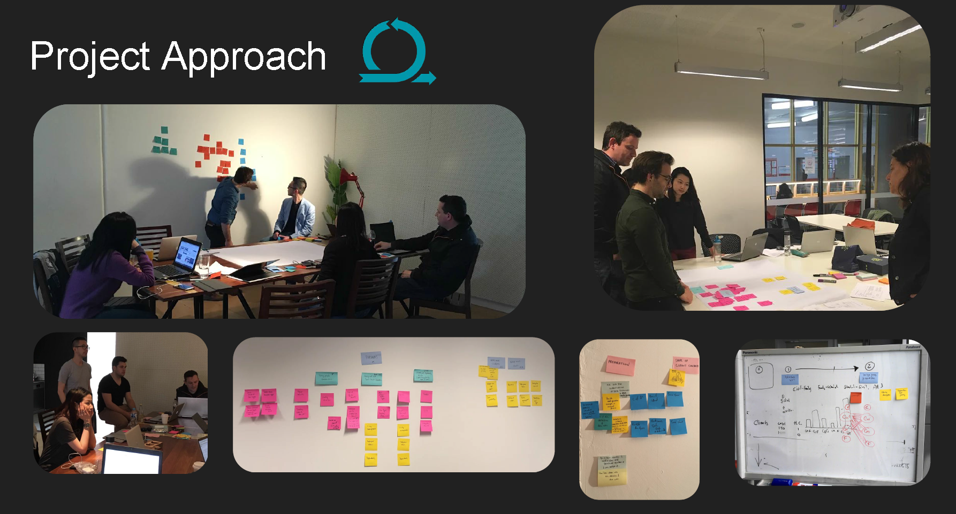
Approach
Notes:
Then they conducted several hackathons, where our original questions were refined and translated into geek speak, and then prioritised.

Slide 5
Patterns of usage over time
Between 2006-16, we provided 1.5 million services to 443,000 clients.
The majority of clients (60%) will use our services in a single year (Single year clients)
14% will come back to us each year after their first service (Repeat users)
Note:
Single year users can be high cost users if they use a large number of services in a single year (eg. Multiple grants of aid)
Repeat users may not be high cost users if they use a lot of low cost services (eg. Legal advice)
Notes:
Over the last 10 years, this is how people have used our services.
Majority Single users (come once, then see you later)
Repeat users (this is an interesting group, they will see us every single year)
Intermittent (see us more than once, but not as often as a repeat user – may have related legal issues over a couple of years.

Slide 6
Guide to interpreting charts
Percentages in the following four charts relate to services delivered. Some clients receive more than one service, so there’ll be more services than clients.
Co-occurring legal problems are where one person has received help from VLA for more than one type of legal problem. Sometimes, legal problems commonly co-occur. For example, if you have a family violence legal problem, you may also have legal problems relating to parenting arrangements and access to children.
Matter type: is a description of the type of legal problem that the person is seeking help for eg. theft.
Programs or program areas: VLA delivers services across three programs
Criminal law (criminal offending, including some driving infringements, breaches of court orders, drug offences)
Family, Youth and Children’s law (including parenting disputes, child support, family violence, child protection)
Civil law (including fines, migration, social security matters, discrimination law)
LGA: is Local Government Area – and is the LGA that the client lives in at the time they received a service from VLA.

Slide 7
GUIDE to interpreting charts
The services received by clients in this report include;
Grants of aid: where VLA has paid for the person to be represented in court.
Duty lawyer: where the person has been assisted by a duty lawyer on the day they appear at court
Legal advice & Minor work: where they have received legal advice, perhaps had some help with documents, but not represented at court.
Note that our legal information services, delivered through our telephone Legal Help line, website and community legal education services, are not included in this report.
Legal services which are more intensive, for example an ongoing case at court, will tend to be more expensive than a less intensive service, such as legal advice or a duty lawyer at court. The type of service provided by VLA depends upon a number of factors, but mainly
The seriousness of the matter, and the potential consequences (for example, if you are facing jail)
The vulnerability of the person, and their ability to help themselves (for example, if the client is a child, or has a disability which may affect their ability to solve their own legal problems)
These matters are more likely to receive more intensive services in the form of a grant of aid.

Slide 8
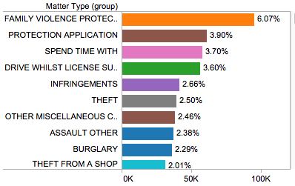
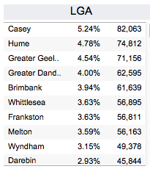
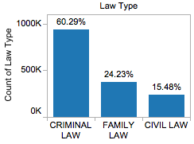
VLA Services
32%
Most common co-occurring legal problems…
Family violence/Parenting arrangements
Theft/Theft from a shop
Family violence/Child protection
68%
Average age : 34
Most common first contact age: 20
42% of services provided were duty lawyer services
Most costly legal problem…
Child protection applications
Gender:
Notes:
Note that all this data will relate to services, not clients, so in others words, read the percentages as a percentage of total service so 32% of our services are to female clients, while 68% are to men.
(go through data)
Median age
Top matters
Duty lawyer predominant service type, Crim dominant program
From Casey, Hume, Greater Geelong
Approx. two thirds of services to men, a third to women.
Co-occurring legal probs include FV and family law/child protection

Slide 9
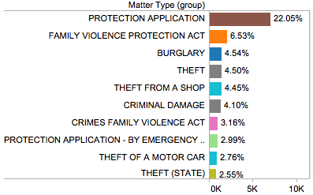
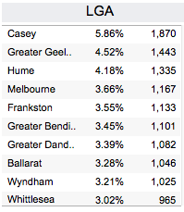
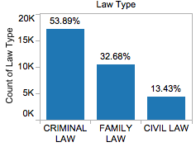
VLA Services : Young people
Most common co-occurring legal problems…
Child protection/Assault
Child protection/Family violence
Child protection/Burglary
36%
64%
Average age: 15
Most common first contact age: 17
45% of services provided were a grant of aid
Most costly legal problem…
Child protection applications
Gender:
Notes:
Note the differences in this group compared with the “all VLA” group
Higher percentage of services going to females
Protection application is the dominant matter type, well ahead of the others
Predominant service type is grant of aid.

Slide 10
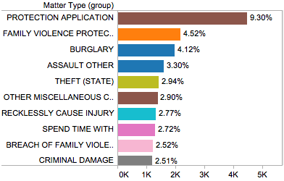
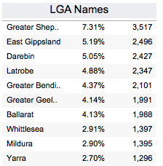
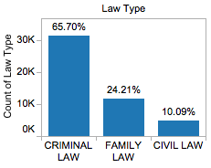
VLA Services : Aboriginal and Torres strait islander
35%
Most common co-occurring legal problems…
Child protection/Family violence
Child protection/Assault
Burglary/Theft
65%
Average age: 29
Most common first contact age: 19
41% of services provided were a grant of aid
Most costly legal problem…
Child protection applications
Gender:
Notes:
Again, let’s have a look at this group and differences/similarities
Younger median age – reflects the younger profile of this group in the community
More services provided to females than in the general group
Similar to young people, child protection applications are the most dominant type of service
The top LGAs are different from the general group – tend to be regional areas
Predominant service type is grant of aid, similar to young people

Slide 11
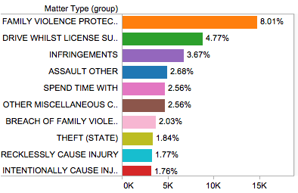
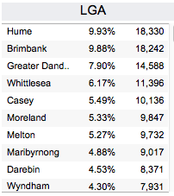
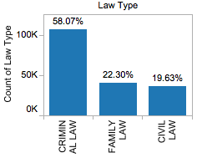
VLA Services : Clients speaking a language other than English (LOTE)
25%
Most common co-occurring legal problems…
Family violence/Parenting arrangements
Family violence/Assault
Family violence/Breach of Family Violence Order
75%
Average age: 37
Most common first contact age: 29
46% of services provided were a duty lawyer service
Most costly legal problem…
Child protection applications
Gender:
Notes:
Unlike ATSI, this profile is older than the general population
Much smaller percentage of services to LOTE females than other categories
Top LGAs tend to be LGAs with higher concentrations of overseas born people
The matter types tend to differ for this group. We see a different range of top matter types, eg. More services in infringement and breaches of family violence in this group (and in ATSI).

Slide 12
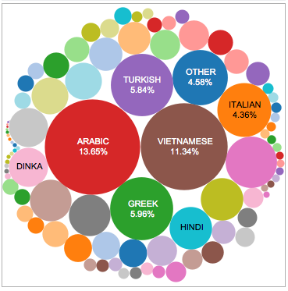
LOTE: countries of origin & main languages spoken
Top countries of origin
Top languages spoken
Notes:
Note top countries or origin and languages spoken. Combination of established communities and newly arrived communities

Slide 13
High cost clients (HCC)
We weighted services to estimate cost
Grant of aid = 15 cost units
Minor work = 2 cost units
Duty lawyer = 1 cost unit
Legal advice = 0.5 cost unit
Then we separated out clients who use the top 10% of services for each year they are active in the VLA database, using a combination of higher than 68 cost units in any combination. This represents 9.4% of clients.
Notes:
We wanted to assess who our ‘high cost’ clients were.
We didn’t provide the students with the actual expenditure on each individual client, however we asked them to come up with a proxy method to assign value to each different service.
From there they came up with the top services per year, and the formula of anything above 68 unit costs representing a ‘high cost’ client.

Slide 14
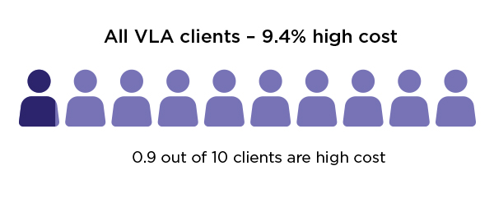
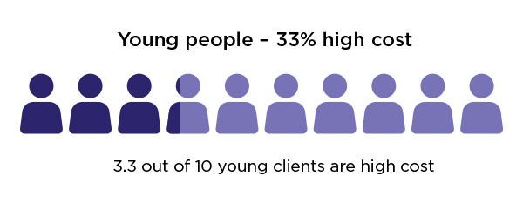
High cost clients at VLA
A quarter of all VLA high cost clients are young, while 7% are Aboriginal and Torres Strait Islander (ATSI)
Of those high cost aged b/w10-15, 60% of services provided were for child protection
There is crossover between Aboriginal and Torres Strait Islander clients and young people, with 8% of HC young people also identifying as Aboriginal and Torres Strait Islander
Notes:
Approximately 1 out of 10 VLA clients is a ‘high cost’ client (using 68 units of cost in any combination)
While
3 out of 10 young clients or ATSI clients is a ‘high cost’ client. This is a significant difference.
These clients are either;
High need (eg. They have higher rates of disability (23%) cf general population (13%)
Eligible for more expensive service types eg. Grant of aid.

Slide 15
Crossover clients
20% of VLA clients receive services from more than one program area.
Of that 20%,
42% received services from both the Criminal and Family
27% received services from both Civil and Criminal
14% received services from Civil and Family
17% received services from all three programs
Notes:
We were also interested in crossover clients and how they may be an indicator of having complex legal needs…
A fifth (20%) of our clients are crossover clients
While the most common type of crossover in programs is Family and Criminal, note too, a fairly large group crossover use all our program types. This is significant as this is likely to indicate a high needs group.

Slide 16
VLA SERVICES: Disability status
Notes:
Higher no. of services provided to clients with disabilities in the category – high cost and ATSI.
Mental health most common disability type for all groups, but note high rates of ABI and intellectual disability amongst High cost, ATSI, and a really high number of services provided to young people with an intellectual disability.
Higher rates of physical disability amongst LOTE, probably reflects the older age profile of this group.

Slide 17
Conclusions
Aboriginality and youth are potential risk factors for repeated use of VLA services
Child protection is almost universally one of our ‘high cost’ services
Child protection is the most common problem type co-occurring with other problems in the young people and ATSI groups
Family violence also appears to commonly co-occur with other legal problems in all clients
Legal aid services (with the exception of our legal information services) are predominantly provided to males, with slightly higher percentages of services provided to females amongst young people and Aboriginal and Torres Strait Islander clients. Services to females who speak a language other than English are significantly lower.
Notes:
Read slide.

Slide 18
LIMITATIONS of data
Changing demographic information not always collected eg. Changing locations, changing family type, employment circumstances – so the demographic data may reflect a person’s circumstances at the time they first came to see us and not capture how it may change over time.
Matter types are very granular and inconsistently defined, and matter types change which makes long term analysis difficult. The granularity and change over time means that some trends may not be easily identified.
Notes:
We have a very rich data set, with a lot of potentially useful information.
However there are limitations, depending on the questions you ask, some of the long term trend data may be harder to analyse..
Main issues relate to dynamic fields which don’t get updated during the course of a client’s interactions with us.
Big problems with matter types and the way they’re set up makes long term analysis difficult. No data dictionary or standardisation in matter types.
Standard data entry errors meaning we have clients who were serviced before they were born.

Slide 19
More information?
You can view the full report on our website, or contact research@vla.vic.gov.au for more information.

